Slide 1
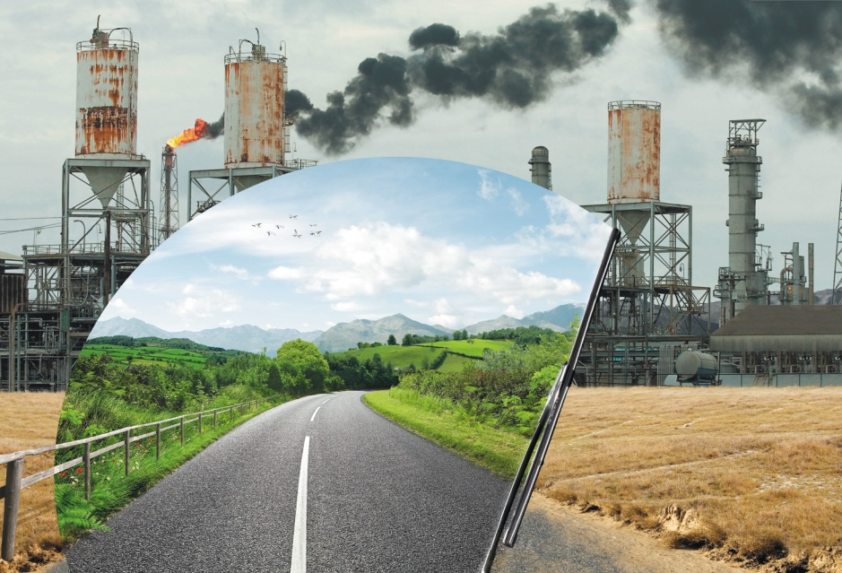
ANTHROPOGENIC IMPACT ON THE ENVIRONMENT
Work done: students of
the Faculty of Biology
Shvetsova Olga
and
Rusakova Anastasia
Scientific director: Filatova E.A.

Slide 2
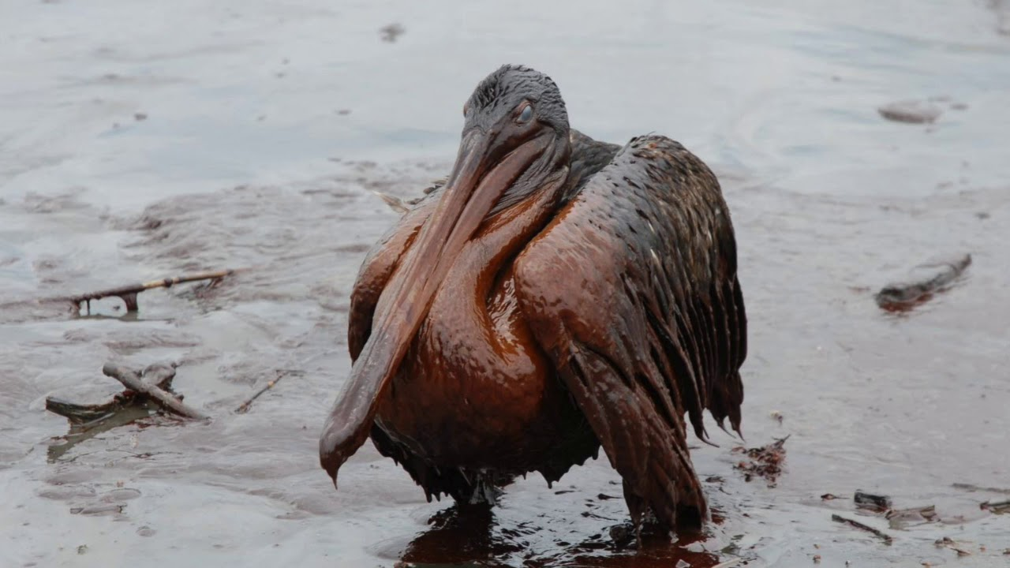
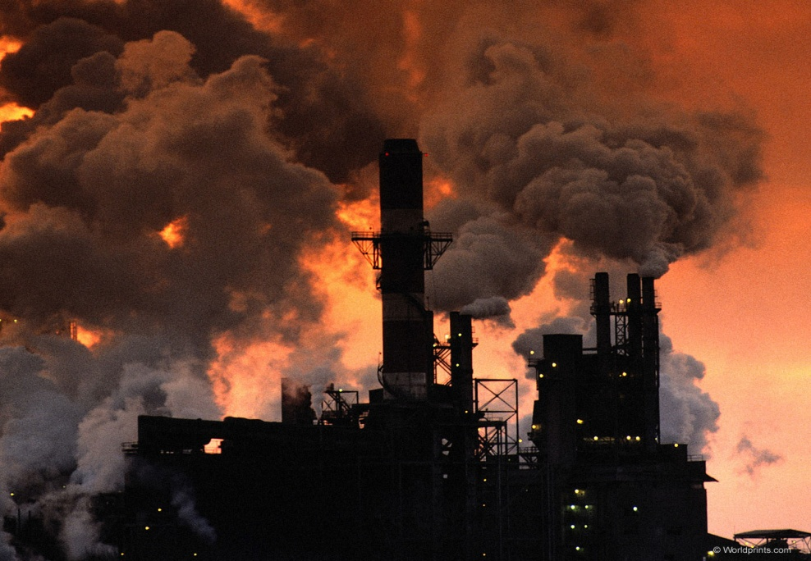
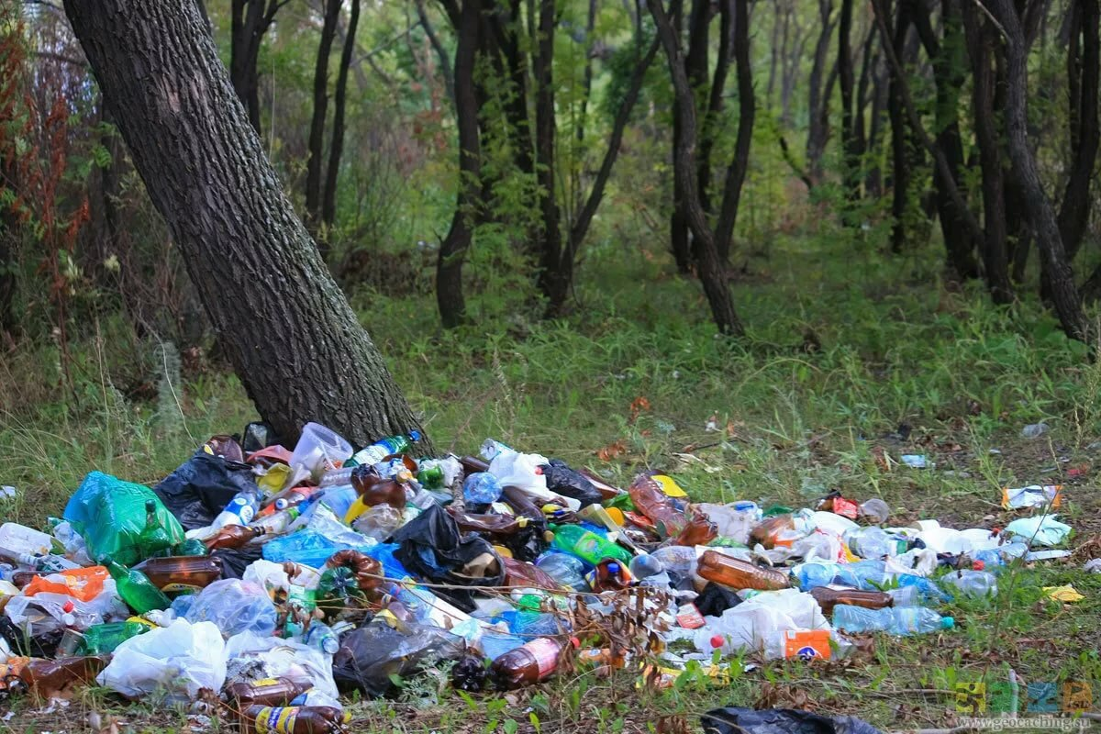
For almost 40 thousand years, people have been trying to subdue nature. Irreversible human impact on nature becomes inevitable.

Slide 3
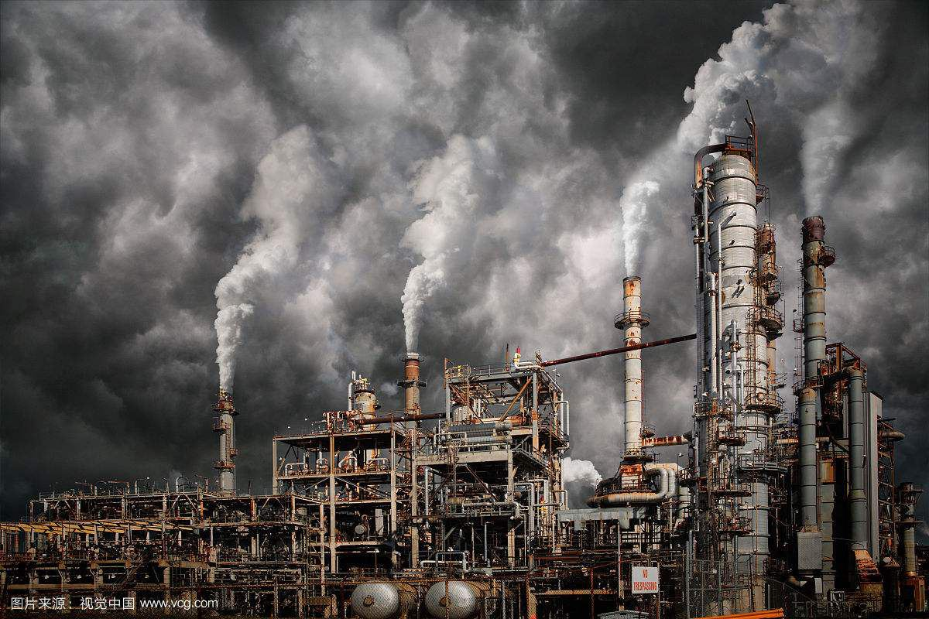
POLLUTION OF THE ATMOSPHERE
The mass of the atmosphere of our planet is negligible - just one millionth of the mass of the Earth, its role in the natural processes of the biosphere is huge, according to scientists, more than 25.5 billion tons of harmful gases enter the atmosphere every year as a result of human activity.

Slide 4
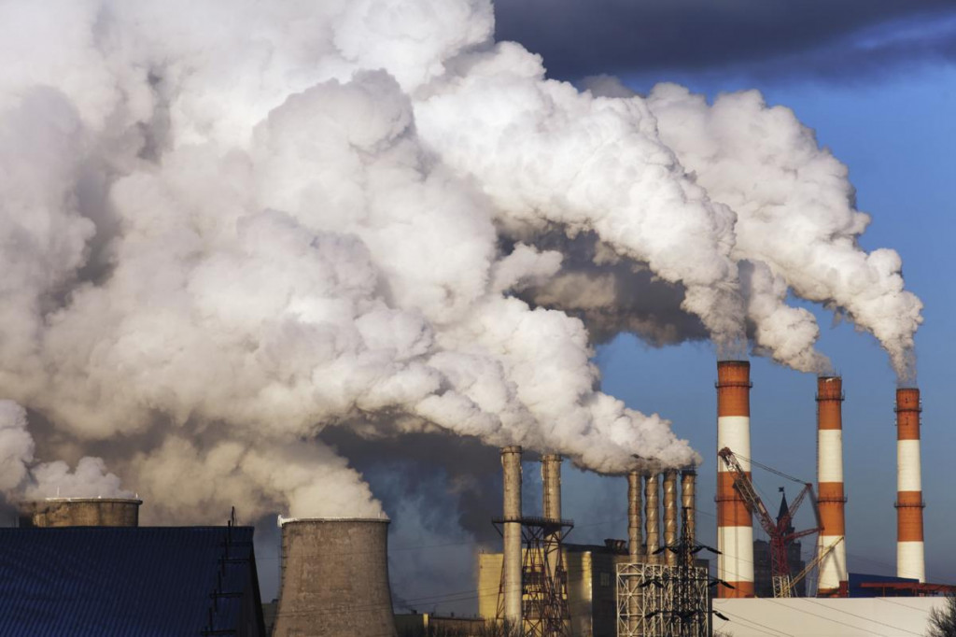
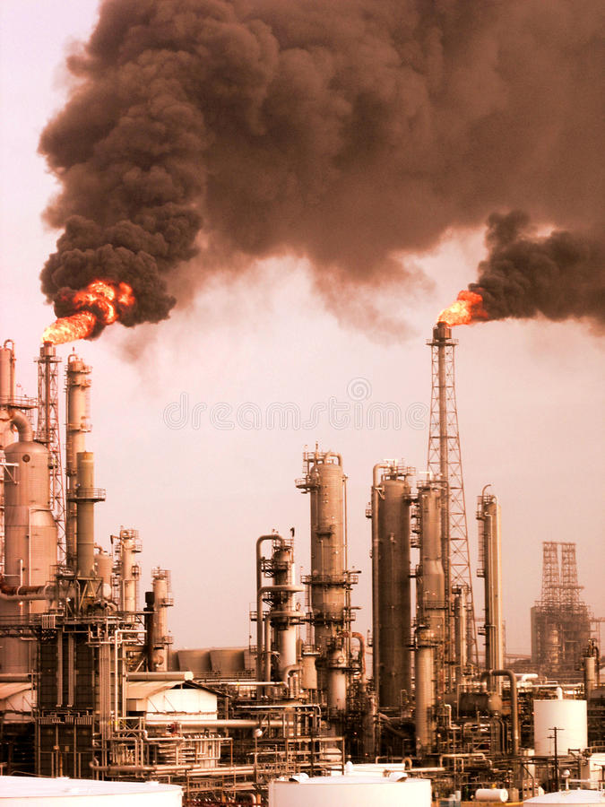
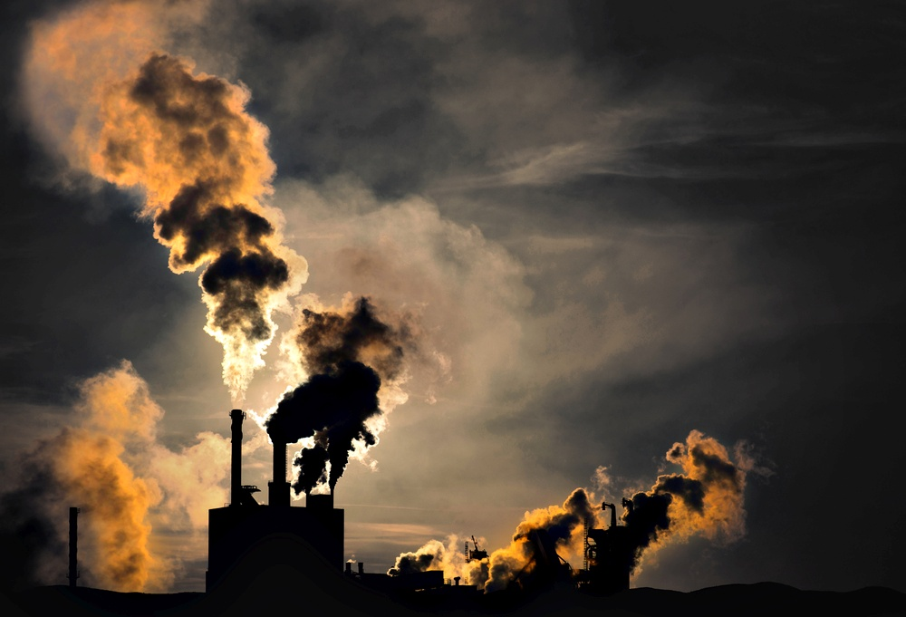

Slide 5
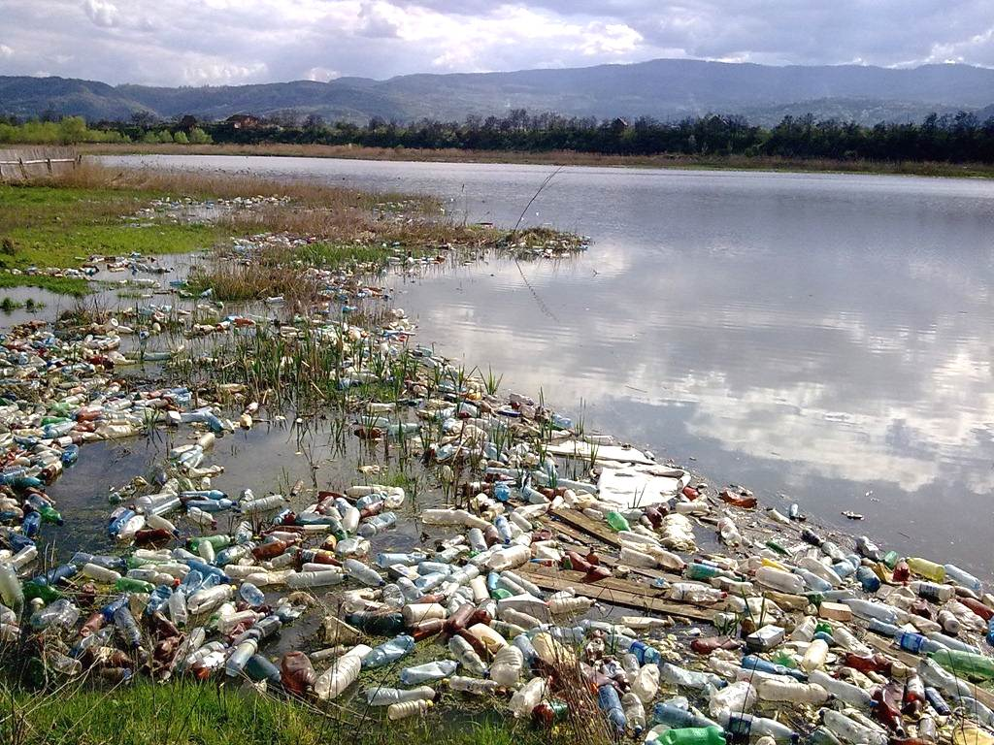
POLLUTION OF NATURAL WATERS

Slide 6
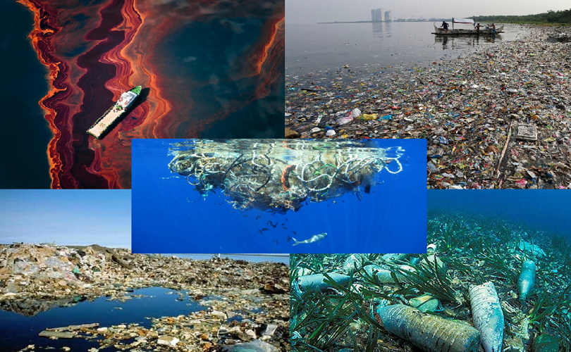

Slide 7
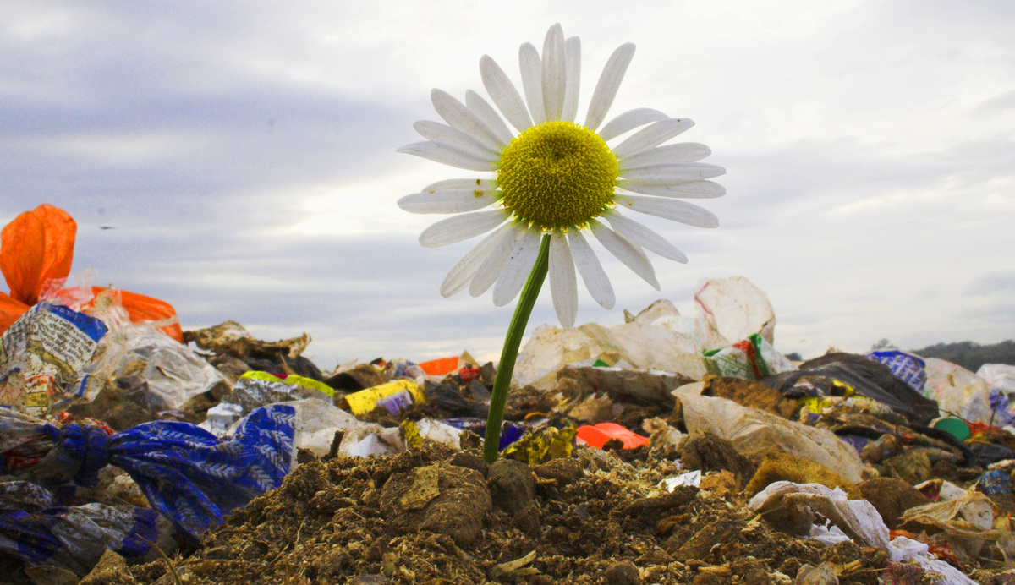
SOIL CONTAMINATION
Their inept and uncontrolled use of soil resources leads to disruption of the circulation of substances in the biosphere.

Slide 8
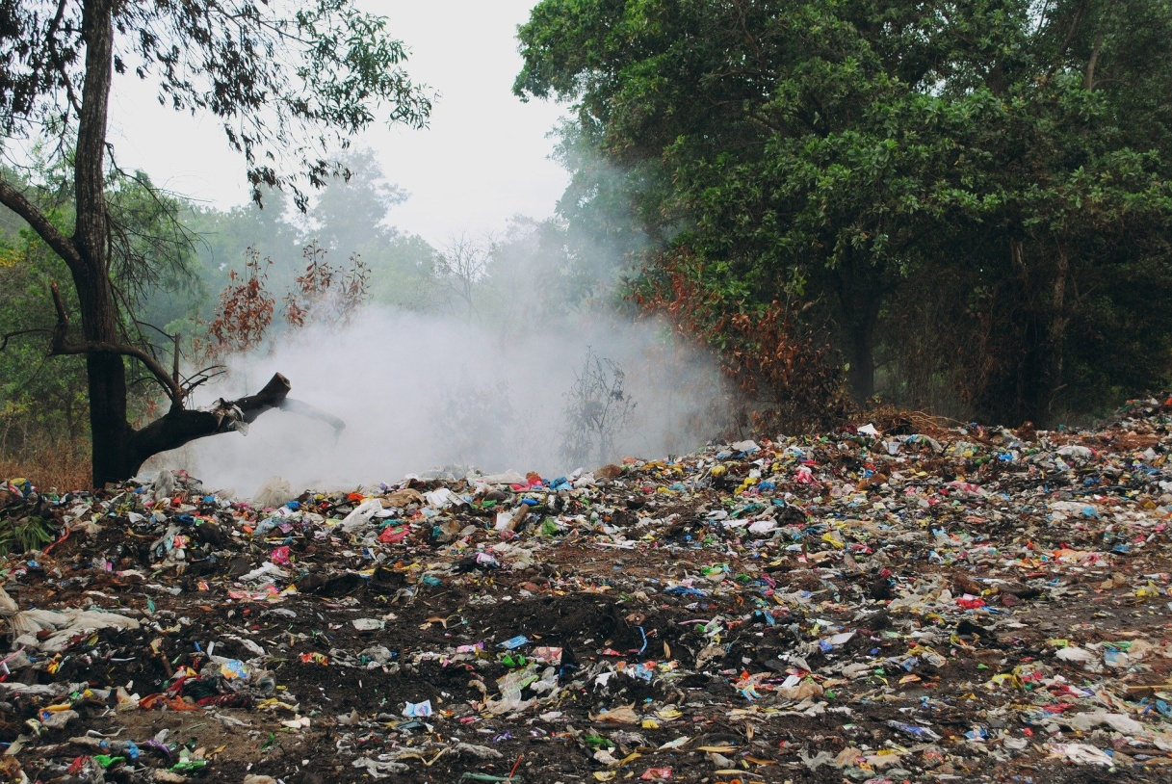
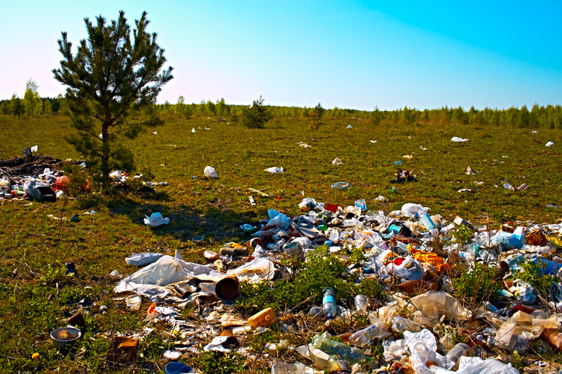

Slide 9
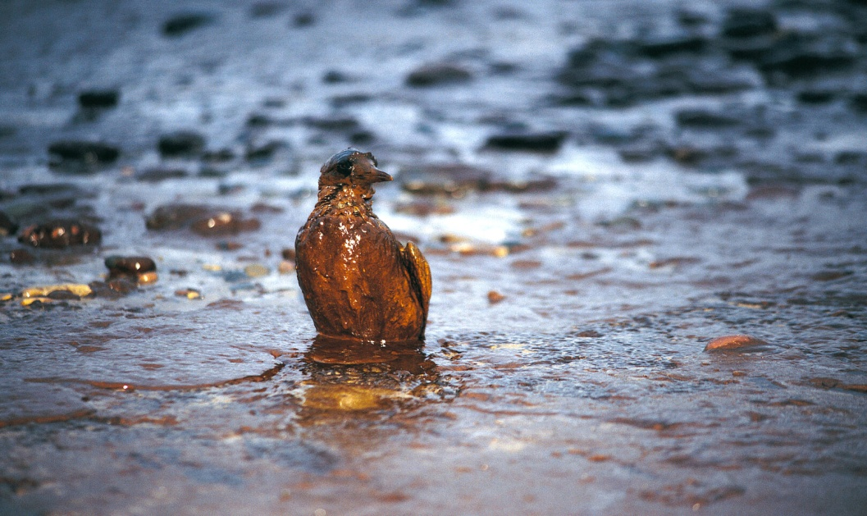
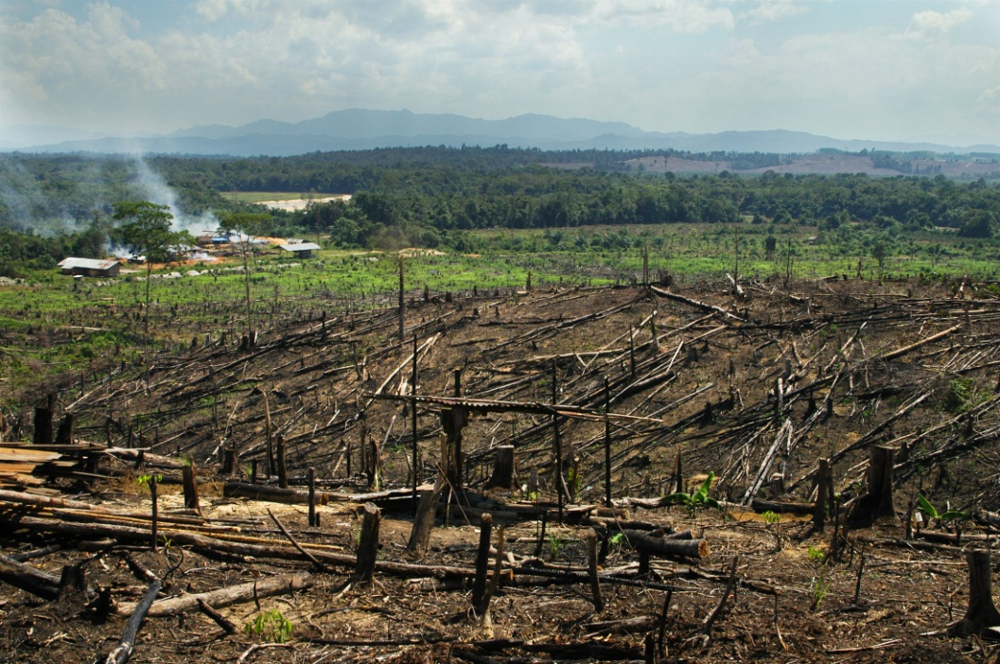
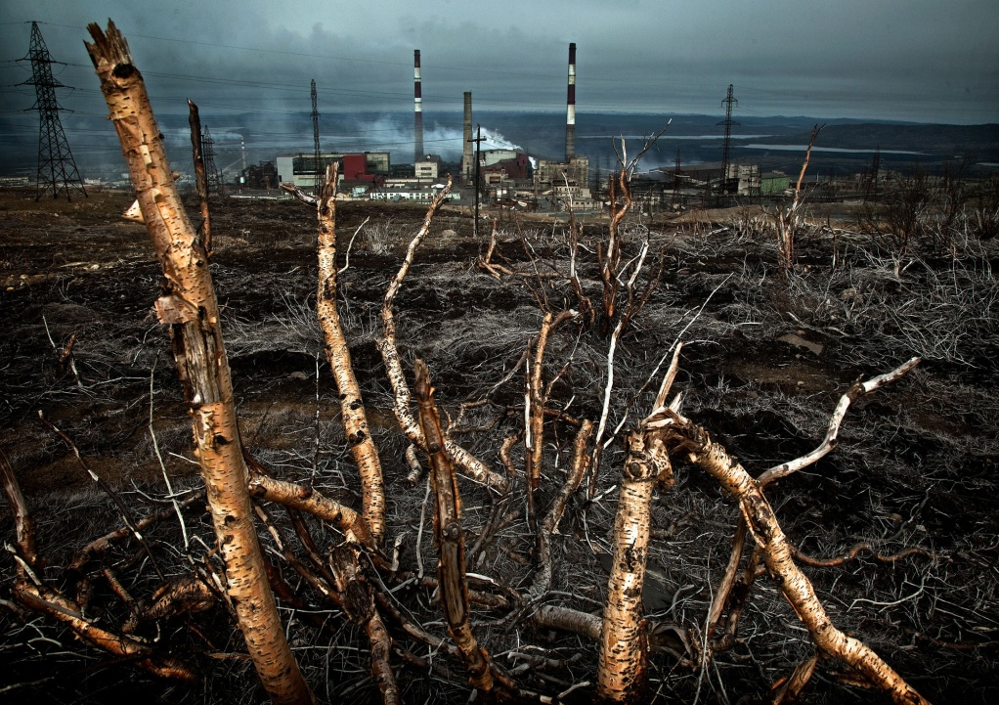
INFLUENCE ON ANIMAL AND PLANT WORLDS
The impact of man on wildlife consists of a direct influence and an indirect change in the natural environment.

Slide 10
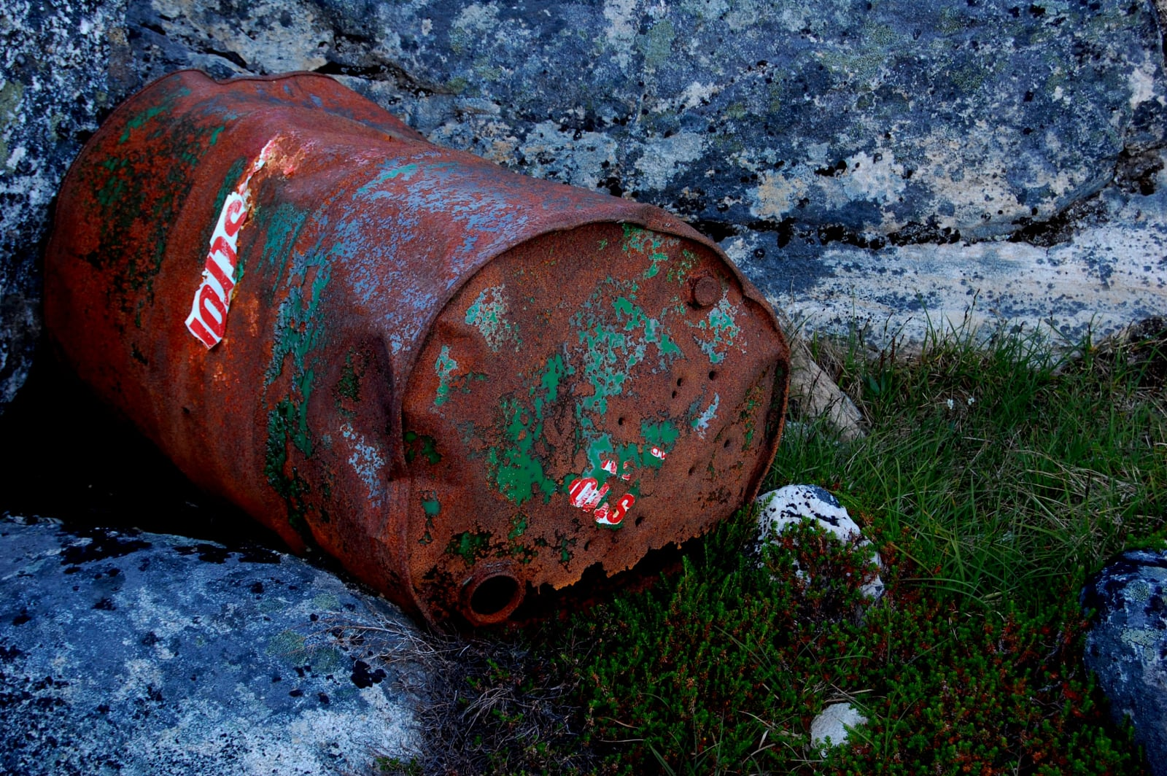
RADIOACTIVE POLLUTION
At present, the problem of storage of radioactive waste is becoming increasingly acute. Every year they pose an increasing danger to the environment.

Slide 11
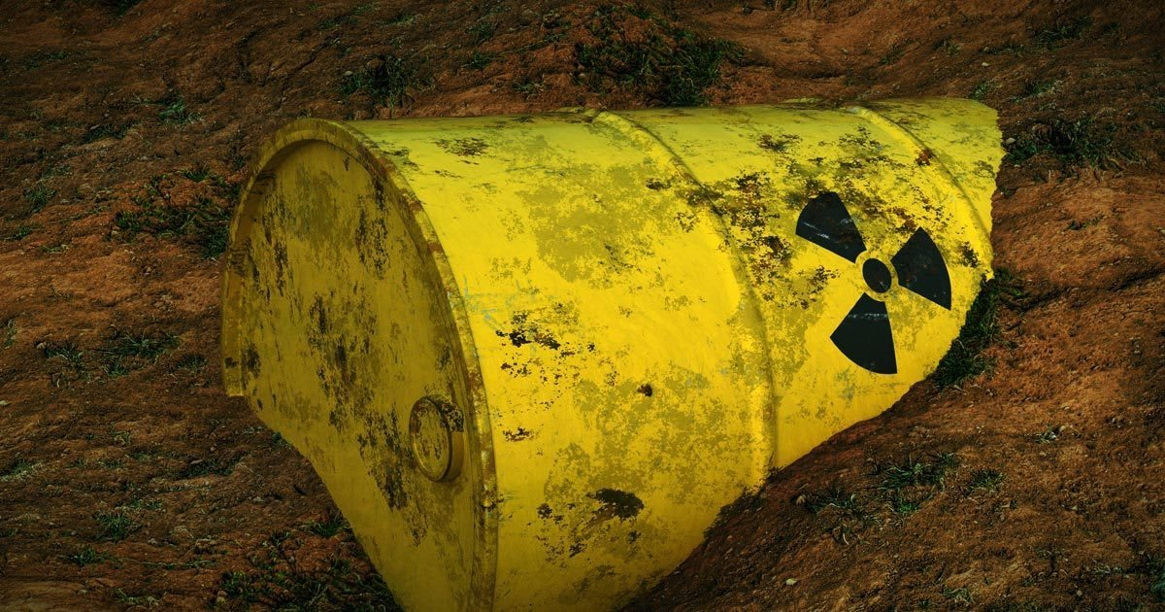
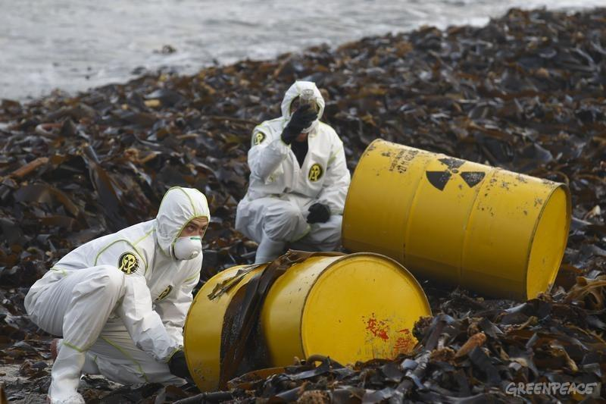

Slide 12
Thanks for attention!

